Slide 1
A Perspective on The Politics of Water
February 6, 2013
Chuck Huling
Strategic Energy Institute
Georgia Tech

Slide 2
Politics
politics (n.) 1520s, "science of government," from politic (adj.), modeled on Aristotle's ta politika "affairs of state," the name of his book on governing and governments, which was in English mid-15c. as "Polettiques." Also see -ics.
Politicks is the science of good sense, applied to public affairs, and, as those are forever changing, what is wisdom today would be folly and perhaps, ruin tomorrow. Politicks is not a science so properly as a business. It cannot have fixed principles, from which a wise man would never swerve, unless the inconstancy of men's view of interest and the capriciousness of the tempers could be fixed. [Fisher Ames (1758-1808)] [emphasis added]
Meaning "a person's political allegiances or opinions" is from 1769.
From “etymonline.com,” Online Etymology Dictionary

Slide 3
"Whiskey is for drinking; water is for fighting over.” Attributed to Mark Twain, but not authenticated
http://www.twainquotes.com/Water.html

Slide 4
Politics of Water
Allocation
Conservation & Efficiency
Economic Development
Environmental (assimilative capacity, endangered species, minimum flows, fisheries, erosion & sedimentation control, etc.)
Growth
Jurisdiction (federal, regional, state, and local)
Interstate Commerce
Permitting
Riparian Rights
State’s Rights
Wastewater (point source and non-point source discharges)
Water and Sewer Rates
Water Quality
Water Quantity
Water Supply
Water Use
Agriculture
Industry
Navigation
Power Production
Public
Recreation
Waste Assimilation
Wildlife Habitat
Etc.

Slide 5
Water Supply

Slide 6
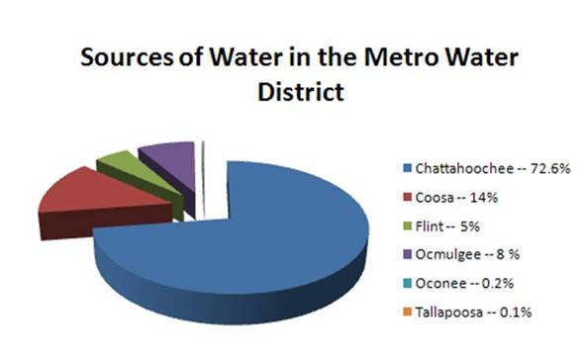
http://www.atlantaregional.com/environment/tri-state-water-wars

Slide 7
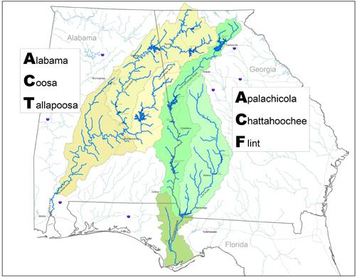
Tri-State Water Wars
Chattahoochee, Coosa, Flint, and Tallapoosa rivers account for ~92 percent of Metro Water District’s source of water.
http://www.atlantaregional.com/environment/tri-state-water-wars

Slide 8
Summary of Tri-State Water Issues
“Each state has its own concerns about the proper allocation of water:”
“Georgia As the upstream user, Georgia wants to have enough water to continue growing, particularly in booming metro Atlanta.
Alabama A downstream user, Alabama is concerned that Atlanta’s ever-increasing thirst for water will severely limit its own use of water for power generation, fisheries and other uses.
Florida Another downstream user, Florida wants enough freshwater to reach the Apalachicola Bay to sustain its multi-million dollar shellfish industry.”
From the Southern Environmental Law Center, www.southernenvironment.org
See also: http://www.atlantaregional.com/environment/tri-state-water-wars; http://www.chattahoochee.org/tri-state-issues.php; http://www.ca11.uscourts.gov/opinions/ops/200914657.pdf

Slide 9
Statewide Water Planning
2004 Comprehensive Statewide Water Management Planning Act - “Georgia manages water resources in a sustainable manner to support the state’s economy, to protect public health and natural systems, and to enhance the quality of life for all citizens.”
Statewide Water Plan adopted by the General Assembly in January 2008 – “The Comprehensive Statewide Water Management Plan provides a framework to measure water resources, to forecast how much water supply and assimilative capacity will be needed to support future growth, and to identify regional solutions to water needs. This plan will help guide the stewardship of Georgia’s precious water resources to ensure that those resources continue to support growth and prosperity statewide while maintaining healthy natural systems.
http://www.georgiawaterplanning.org

Slide 10
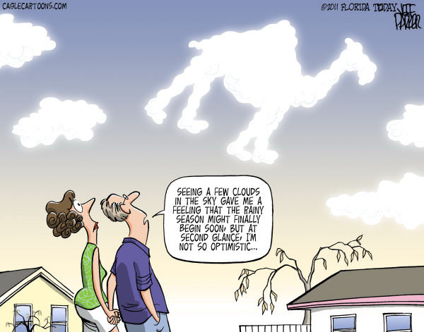
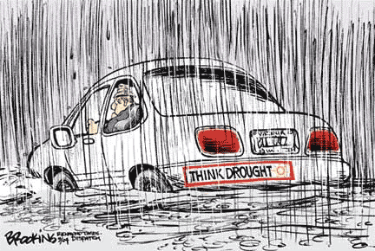
Importance of timing!

Slide 11
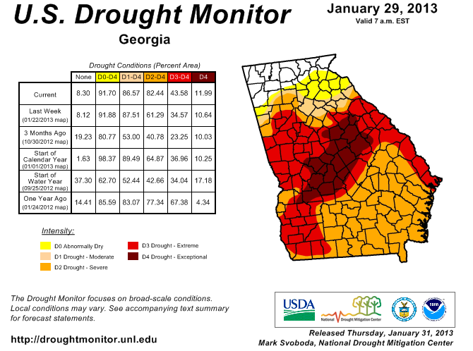
Return to U.S. Drought Monitor | Return to Region

Slide 12
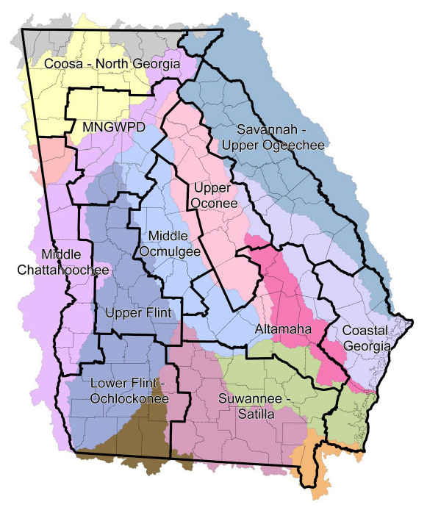
Regional Basin Boundaries
“All politics is local.”
Thomas Phillip "Tip" O'Neill, Jr. (December 9, 1912 – January 5, 1994), former Speaker of the U.S. House of Representatives.

Slide 13
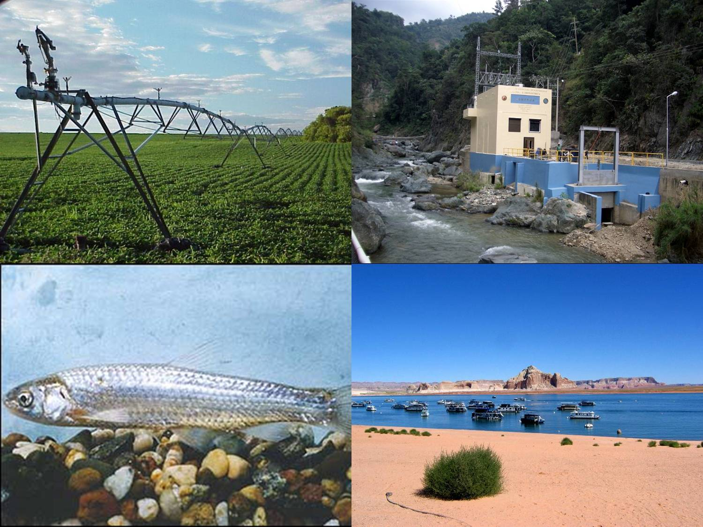
Water Use

Slide 14
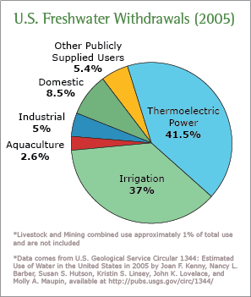

Slide 15
Understanding the Dynamics Agriculture Example
“Agriculture is the most dominant sector generating largest portion of Georgia income ahead of financial sector, real estate sector and retail sector.” ¹
General ²
Georgia produces almost half of the peanuts produced in the U.S. each year, value more than $401 million in 2009.
Georgia leads the nation in broilers and value of egg production. In 2009, broilers valued at $4 billion dollars and eggs at more than $570 million .
One of out of seven Georgians works in agriculture, forestry or a related sector.
Agriculture contributes more than $67 billion, or about 12%, annually to Georgia’s $787 billion dollar economic output.
More than 65% of Georgia is in forestland. Forestry is a $16.7 billion per year industry in Georgia.
Georgia ranks first in the U.S. in the production of peanuts, pecans, rye, eggs and broilers.
Food Industry in Georgia ³
Employs more than 58,700 individuals;
Has more than 875 small, medium, and large companies located across the state;
Has a total value of shipments in excess of $16.2 billion annually.
¹ economy watch.com
² http://www.agclassroom.org
³ http://foodpac.gatech.edu/foodind.html

Slide 16
Understanding the Dynamics Electric Utility Example

Slide 17
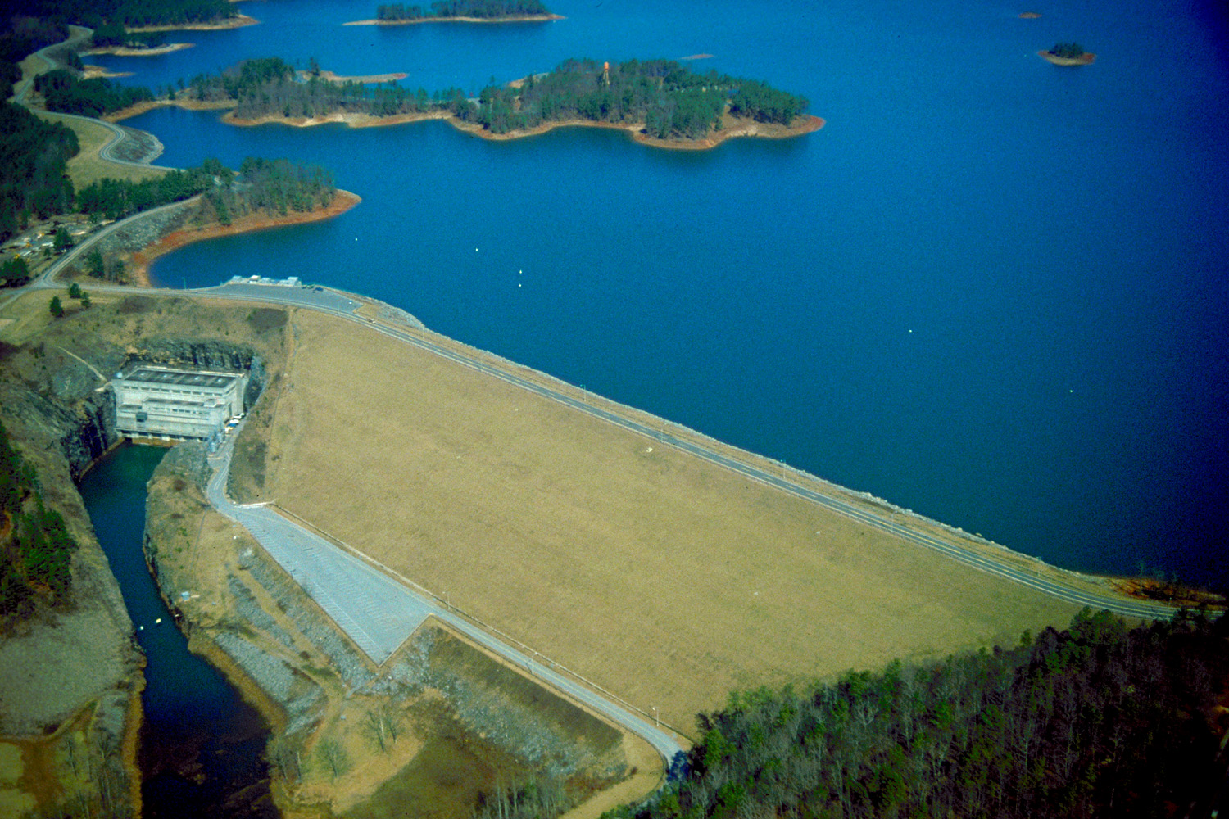
Hydroelectric Power
Buford Dam, U.S. Army Corps of Engineers

Slide 19
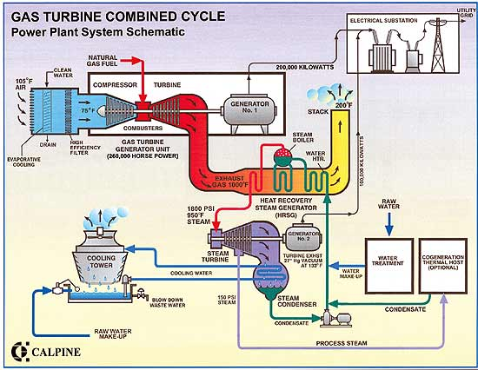

Slide 20
Power Plant Water Use

Slide 21
Water Risk Areas for Electric Power Generators ¹
Physical
Too little water
Poor water quality (e.g., temperature, TDS, metals)
Regulatory
Water withdrawal permits denied
CWA 316(a) / 316(b), TMDLs, NPDES permit compliance, endangered species, effluent guidelines
Reputational
Labeled as “biggest water hog” compared other sectors
Public pressure / lawsuits (new power plants, conversion of cooling tech.)
Financial
Curtailment / shut down under limited water resources
Water efficient technologies are expensive
¹ © 2012 Electric Power Research Institute, Inc. All rights reserved.
Source: Pacific Institute, 2009 (Water Scarcity and Climate Change); World Business Council, 2009 (Why Water is Everyone’s Business)

Slide 22
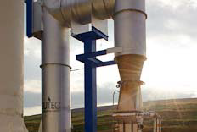
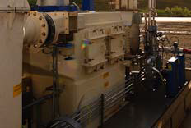
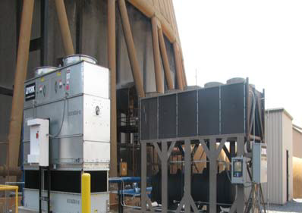
Water Research Center
An Industry Resource for Power Plant Water
Management Technology R&D
Plant Bowen, Cartersville, GA
© 2012 Electric Power Research Institute, Inc.

Slide 23
The Politics of Water Some Key Takeaways
Understand the facts
What are the critical factors? (ex., environmental, public, economic, etc.)
Understand the dynamics
What is said, who said it, and why?
What is unsaid, who should have said something but didn’t, and why?
What is at stake, and to whom?
Who are the major “players?”
Follow the money
Who are the ultimate decision-makers?
The solution should balance critical factors

Slide 24
GO JACKETS!
®

